Slide 1
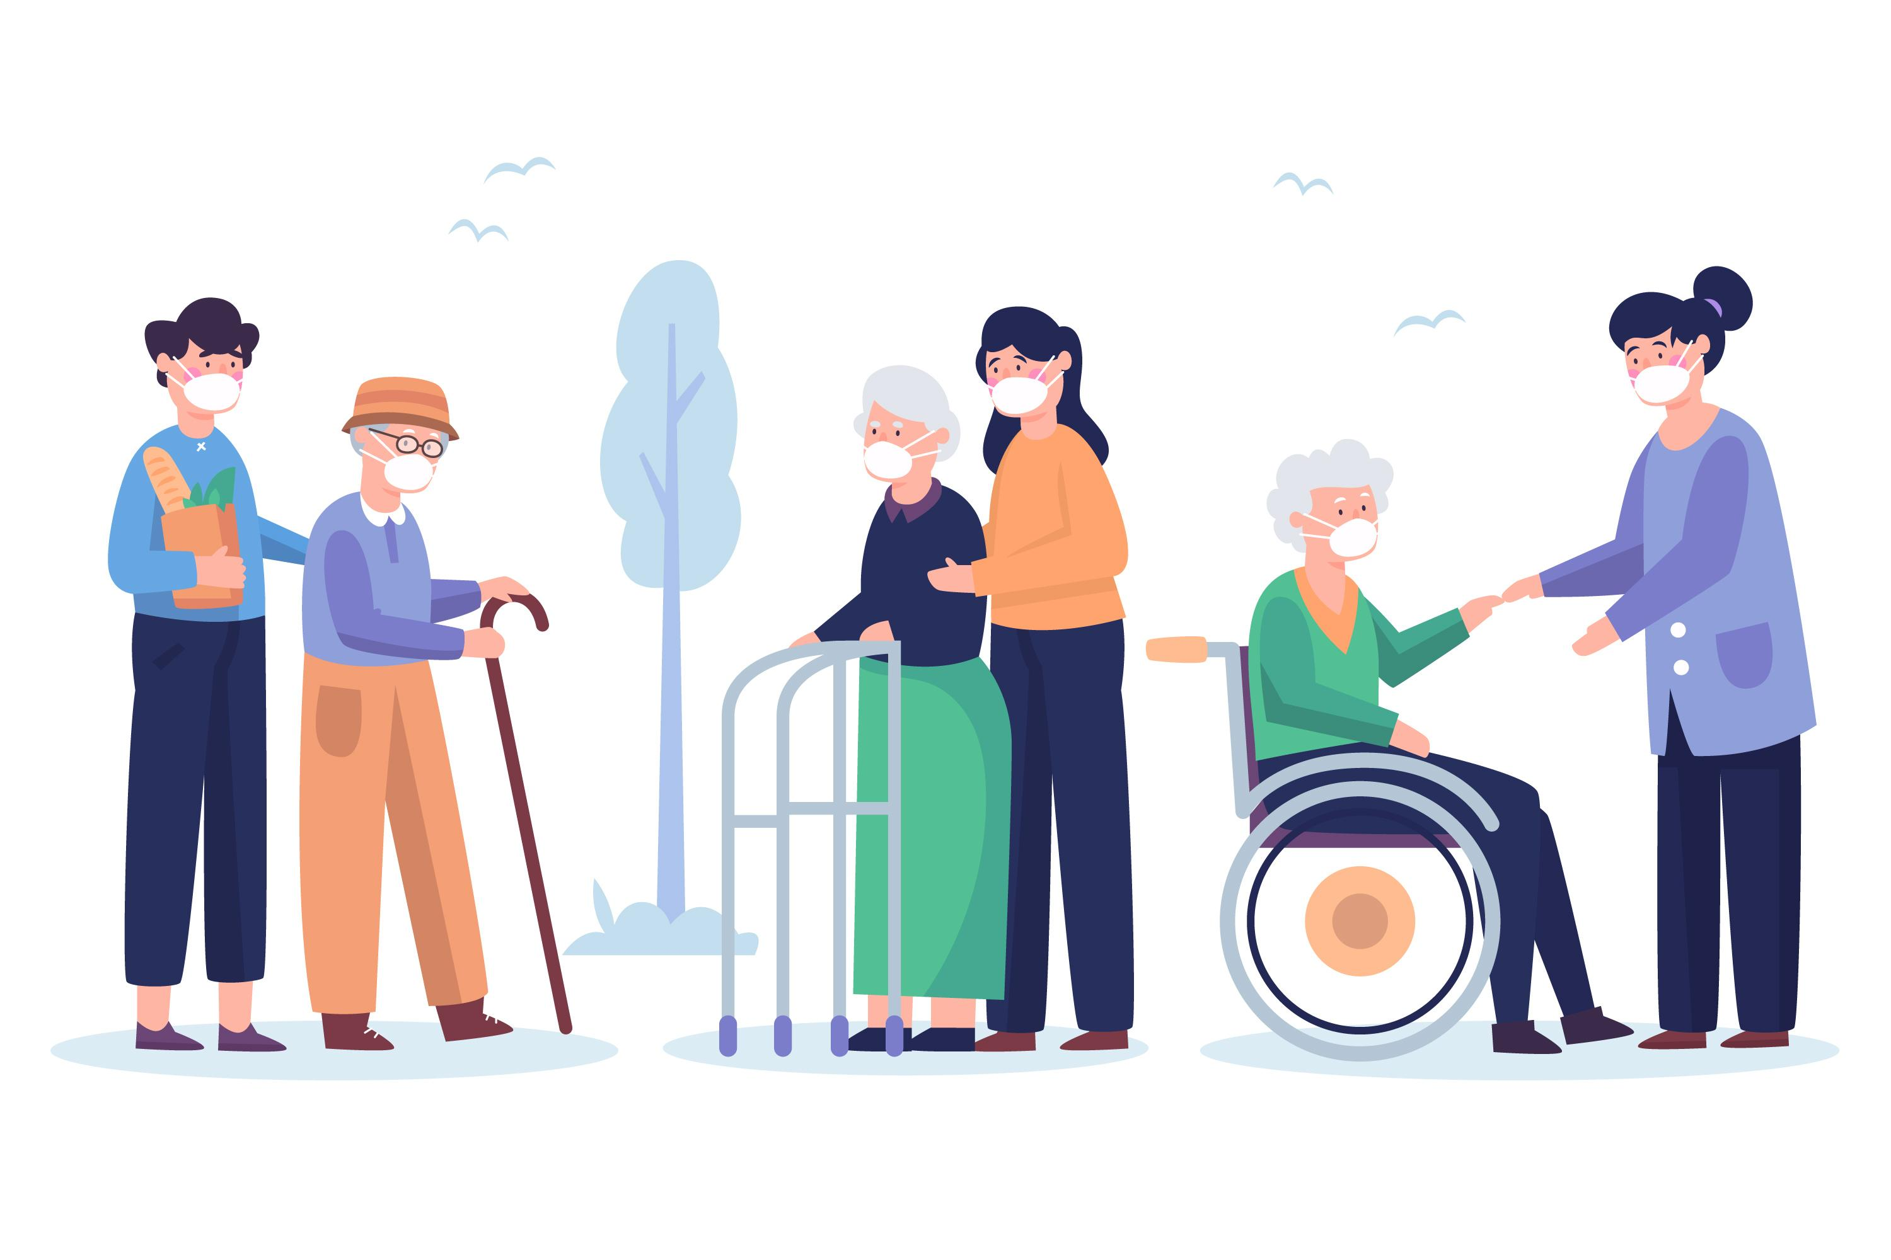
Elderly support
Joel, Yuki, Faith, Shang En, Shang Hong
Notes:
Good morning/afternoon
Presenting our webapp called elderly support
It is a webapp that mobilises youth to deliver groceries to the elderly

Slide 2

Presentation outline
Societal needs
Our solution
Limitations
Future direction
Notes:
Here’s the outline of my presentation
Start with the societal needs to provide context on why we made Elderly support
We will then dive in to see how Elderly support works and its unique features
We will then evaluate our project
Finally, we’ll highlight some future directions for this project

Slide 3

Societal needs
Notes:
- Moving on to the first portion of this presentation – societal needs

Slide 4



Societal needs
Elderly the most vulnerable strata of society to COVID-19
Elderly urged to stay home as much as possible
Getting essential goods a challenge
Current grocery shopping apps hard to use and unintuitive for elders
Increasing number of elderly living alone and have no one to teach them
Limited delivery slots on grocery apps
Finding a slot for grocery to be delivered a challenge for elders
Notes:
Three main problems faced by society
Firstly, elderly the most vulnerable strata of society to COVID-19 pandemic. Globally, at least 80% of all COVID-19 deaths are seniors aged 60 and above. Hence, governments worldwide has urged senior citizens to stay home as much as possible. Thus, obtaining essential goods has become a challenge for the elderly. This has been exacerbated by the fact that senior citizens are increasingly starting to live alone. According to the WHO, In some European countries, more than 40 percent of women aged 65 or older live alone.
Next, there is also currently no integrated platform that allows elders the option to buy products from multiple supermarkets. Coupled with the unintuitive user interfaces of current grocery apps, online grocery shopping turns into a nightmare for elders who are not digital natives.
Lastly, when a country undergoes lockdown, grocery delivery services are being oversubscribed by all strata of society. There is currently no priority given for elderly and vulnerable populations to tap on delivery services. Even if the elders manage to navigate the app, they are likely to be unable to obtain a delivery slot. Hence, elders will be forced to head out to obtain necessities and be exposed to the virus.

Slide 5
Our solution
Notes:
With these problems in mind, we’ll be moving on to the solution overview

Slide 6
Solution aims
Elder friendly design
Smart and intuitive ordering system
Availability of delivery slots
Notes:
The solution proposed will cover 3 aims:
Elder friendly user interface
Smart and intuitive ordering system
Availability of delivery slots

Slide 7











How our app works
Susan signs up
Susan keys in order
Jack selected to help Susan. Order summary and Susan’s details sent to Jack
Jack buys groceries
Jack delivers grocery to Susan’s house
Notes:
Here, we will explain how our app works.
Susan signs up to be an elderly beneficiary
Susan utilises our smart ordering system to buy her groceries
Jack is a youth that signs up to be a volunteer. He opted to help Susan buy her groceries. Susan’s order summary and details are hence sent to Jack.
Jack buys Susan's groceries
Jack delivers Susan’s groceries to her doorstep.

Slide 8










How our app works
Susan signs up
Susan keys in order
Order summary and elderly details sent to Jack that selected to help Susan
Jack buys groceries
Jack delivers grocery to Susan’s house
Smart ordering system
Notes:
Next we will go over the highlights of our app, starting with the smart ordering system!

Slide 9
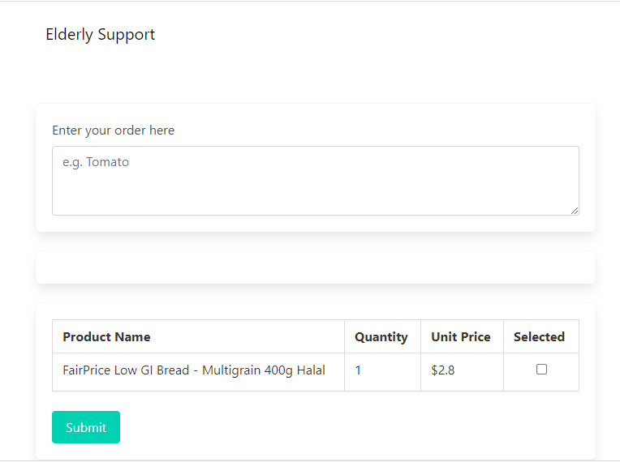
Smart and intuitive ordering system
Choice of speech or text (for elderly who may not be able to write/disability)
Fuzzy matching (For the elderly whose first lang not eng. Many.)
Multiple languages (% of Chinese speaking elderly)
Natural conversation experience
Notes:
Our smart ordering system has 4 main advantages:
1. It has the option of using speech or text. All grocery shopping apps in Singapore only have text search function. However, many elderly citizens did not receive formal educate and hence have limited writing ability. Thus, the choice to speak removes the frustration of spelling and makes the online grocery shopping experience more elder friendly.
2. Our smart ordering system is powered by Google machine learning and thus allows for a natural conversation experience. Natural language understanding recognizes a user’s intent and extracts prebuilt entities such as time, date, and numbers. For example, you can tell the app that you want 1 banana and 2 apples. The system is able to identify and record the product and quantity respectively. This emulates the action of telling a family member what groceries you want them to buy and allows for natural conversation experience.
3. Fuzzy match in text and speech. For elderly who do not use English as 1st lang, they may have many spelling error in their types or spoken order. This is especially so where users are in a hurry and don’t emphasize correct spelling or grammar in their conversations. Our search function will not only automatically corrects spelling and speech mistakes but it will also recognise their intent and show them the product they desire.
4. Lastly, our platform supports multiple languages beyond English. We recognise that while English is increasing in popularity among the younger generations, it is not the mother tongue for many senior citizens. For example, in Singapore, Chinese make up the majority of the local population at 74.3 per cent. Of the Chinese population, about 1 in 3 people use mandarin at home. Hence, the ability to cater to senior citizens’ native languages will decrease the difficulty experience in obtaining groceries online.

Slide 10
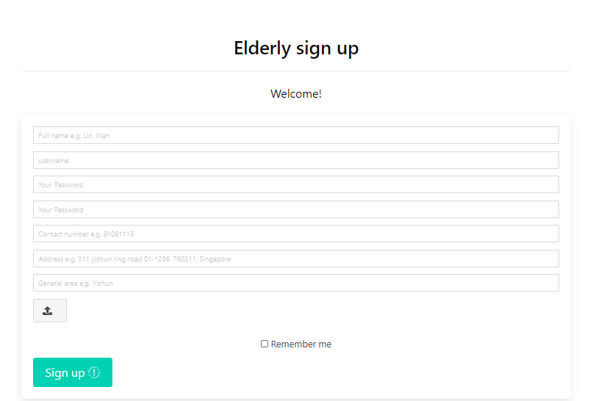
Other highlights
Easy to navigate interface
Mobilising sections of society to address social needs!
Notes:
Next, I will go on to briefly touch on the other highlights:
It has a simple, frill-free yet beautiful interface catered for the elderly. We recognise that many products in the market targeting seniors are Ms Britt Monti, creative leader at Ikea of Sweden said that “what's on the market today are ugly and expensive”.
Mobilising sections of society to address social needs.

Slide 11
evaluation
Notes:
Now, we’ll be moving on to the evaluation of our project

Slide 12


Limitations
Misuse by non-elderly
Lack of volunteers
Notes:
We anticipate that our project will face 2 main problems.
As we aim to prioritise serving the elderly, we risk non-elders leeching off our services. Hence, we have included a concession card upload function for elderly to prove their elderly status. This safeguards our platform against misuse by non-elderly.
We foresee that there might be a lack of volunteers for our project. Hence, one possible solution to this will be to have a commercialisation strategy to turn our project into a social enterprise. Above having social value, our project will have economic value as we employ youths who may have been laid off due to COVID-19.

Slide 13
Future direction
Notes:
Now, we’ll be moving on to the future direction of our project

Slide 14



Future direction
User interface
Addition of a browsing function
Educational videos attached to guide users
Adapted for early stage dementia patients
Administration
Donations (if we are operating as a charity)

Slide 15
Thank you!

